Slide 1
Unit -6
Transactions Management and Concurrency

Slide 2
Outline of Unit - 6
Transaction concept, Transaction states, ACID properties
Concurrent Executions, Serializability – Conflict and View,
Concurrency Control: Lock-based, Timestamp-based protocols.
Recovery System: Failure Classification, Log based recovery,
ARIES, Checkpoint, Shadow paging.
Deadlock handling

Slide 3
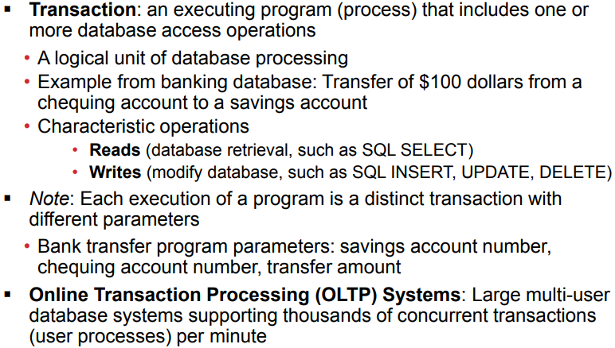
Transaction concept

Slide 4
Transaction concept
A transaction is a logical unit of work of database processing that includes one or more database access operations.
A transaction can be defined as an action or series of actions that is carried out by a single user or application program to perform operations for accessing the contents of the database.
The operations can include retrieval, (Read), insertion (Write), deletion and modification. A transaction must be either completed or aborted.

Slide 5
Transaction concept
A transaction is a logical unit of work of database processing that includes one or more database access operations.
A transaction can be defined as an action or series of actions that is carried out by a single user or application program to perform operations for accessing the contents of the database.
The operations can include retrieval, (Read), insertion (Write), deletion and modification.

Slide 6
Transaction concept
A transaction can include the following basic database access operations:
A transaction is a sequence of READ and WRITE actions that are grouped together to from a database access.
A transaction may consist of a simple SELECT operation to generate a list of table contents, or it may consist of a series of related UPDATE command sequences.

Slide 7
Transaction concept
A transaction must be either completed or aborted.
A transaction is a sequence of READ and WRITE actions that are grouped together to from a database access.
A transaction may consist of a simple SELECT operation to generate a list of table contents, or it may consist of a series of related UPDATE command sequences.

Slide 8
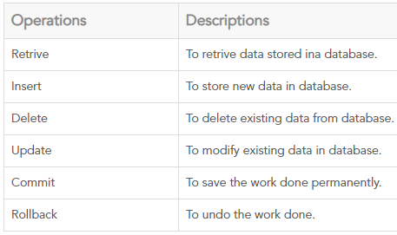
Transaction concept
A transaction can include the following basic database access operations:

Slide 9
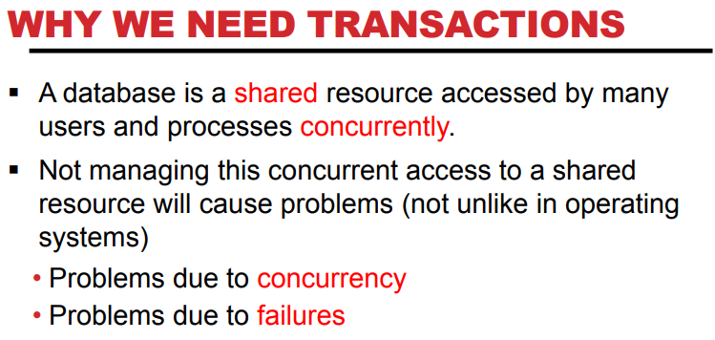
Transaction concept

Slide 10
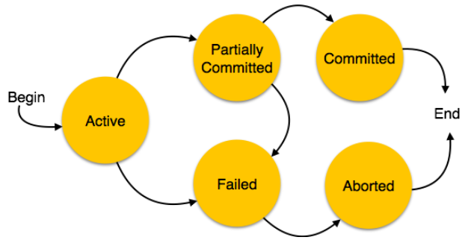
Transaction states
A transaction in a database can be in one of the following states −

Slide 11
Transaction states
A transaction can be in one of the following states:
Active − In this state, the transaction is being executed. This is the initial state of every transaction.
A transaction goes into an active state immediately after it starts execution, where it can issue READ and WRITE operations.
A transaction may be aborted when the transaction itself detects an error during execution which it cannot recover from,

Slide 12
Transaction states
For example, a transaction trying to debit loan amount of an employee from his insufficient gross salary. A transaction may also be aborted before it has been committed due to system failure or any other circumstances beyond its control.

Slide 13
Transaction states
Partially Committed − When a transaction executes its final operation, it is said to be in a partially committed state.
When the transaction ends, it moves to the partially committed state. When the last state is reached.
To this point, some recovery protocols need to ensure that a system failure will not result in an inability to record the changes of the transaction permanently.
Once this check is successful, the transaction is said to have reached its commit point and enters the committed state.

Slide 14
Transaction states
Failed − A transaction is said to be in a failed state if any of the checks made by the database recovery system fails. A failed transaction can no longer proceed further.
A transaction which successfully completes its execution is said to have been committed. Otherwise, the transaction is aborted.
Thus, if a committed transaction performs any update operation on the database, its effect must be reflected on the database even if there is a failure.

Slide 15
Transaction states
Aborted −
If any of the checks fails and the transaction has reached a failed state, then the recovery manager rolls back all its write operations on the database to bring the database back to its original state where it was prior to the execution of the transaction.
Transactions in this state are called aborted.
When the normal execution can no longer be performed.

Slide 16
Transaction states
Aborted −
Failed or aborted transactions may be restarted later, either automatically or after being resubmitted by the user as new transactions
The database recovery module can select one of the two operations after a transaction aborts −
  Re-start the transaction
  Kill the transaction

Slide 17
Transaction states
Committed −
If a transaction executes all its operations successfully, it is said to be committed. All its effects are now permanently established on the database system.
After successful completion of transaction.
A transaction is said to be in a committed state if it has partially committed and it can be ensured that it will never be aborted.

Slide 18
Transaction states
Transaction moves between these various states -
Once a transaction states execution, it becomes active. It can issue READ or WRITE operation.
Once the READ and WRITE operations complete, the transactions becomes partially committed state.
Next, some recovery protocols need to ensure that a system failure will not result in an inability to record changes in the transaction permanently. If this check is a success, the transaction commits and enters into the committed state.

Slide 19
Transaction states
Transaction moves between these various states –
4. If the check is a fail, the transaction goes to the Failed state.
5. If the transaction is aborted while it's in the active state, it goes to the failed state. The transaction should be rolled back to undo the effect of its write operations on the database.
6. The terminated state refers to the transaction leaving the system.

Slide 20
ACID properties
A transaction is a very small unit of a program and it may contain several lowlevel tasks. A transaction in a database system must maintain.
A transaction must have the following four properties, called ACID properties (also called ACIDITY of a transaction), to ensure that a database remains stable state after the transaction is executed:
Atomicity.
Consistency.
Isolation.
Durability.

Slide 21
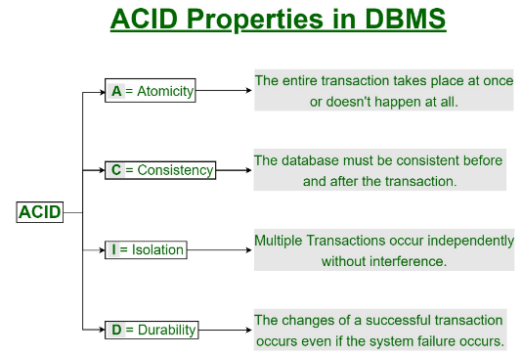
ACID properties

Slide 22
ACID properties
Atomicity −
This property states that a transaction must be treated as an atomic unit, that is, either all of its operations are executed or none.
There must be no state in a database where a transaction is left partially completed.
States should be defined either before the execution of the transaction or after the execution/abortion/failure of the transaction.
The atomicity property of a transaction requires that all operations of a transaction be completed, if not, the transaction is aborted.

Slide 23
ACID properties
Consistency −
The database must remain in a consistent state after any transaction.
No transaction should have any adverse effect on the data residing in the database. If the database was in a consistent state before the execution of a transaction, it must remain consistent after the execution of the transaction as well.
In other words, execution of a transaction must leave a database in either its prior stable state or a new stable state that reflects the new modifications (updates) made by the transaction.

Slide 24
ACID properties
Isolation −
In a database system where more than one transaction are being executed simultaneously and in parallel, the property of isolation states that all the transactions will be carried out and executed as if it is the only transaction in the system.
No transaction will affect the existence of any other transaction.
Isolation property of a transaction means that the data used during the execution of a transaction cannot be used by a second transaction until the first one is completed.

Slide 25
ACID properties
Isolation −
This property isolates transactions from one another.In other words, if a transaction T1 is being executed and is using the data item X, that data item cannot be accessed by any other transaction (T2………..Tn) until T1 ends.
The isolation property is enforced by the concurrency control subsystem of the DBMS.

Slide 26
ACID properties
Durability −
The database should be durable enough to hold all its latest updates even if the system fails or restarts.
If a transaction updates a chunk of data in a database and commits, then the database will hold the modified data.
If a transaction commits but the system fails before the data could be written on to the disk, then that data will be updated once the system springs back into action.
Durability property is the responsibility of the recovery subsystem of the DBMS.

Slide 27
Concurrent Executions
Concurrency is the number of requests that your function is serving at any given time. When your function is invoked, Lambda allocates an instance of it to process the event.
When the function code finishes running, it can handle another request. If the function is invoked again while a request is still being processed, another instance is allocated, which increases the function's concurrency.

Slide 28
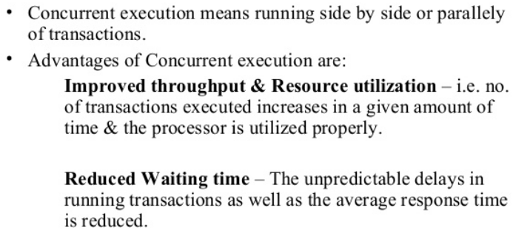
Concurrent Executions

Slide 29
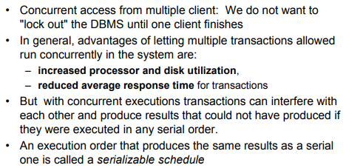
Concurrent Executions

Slide 30
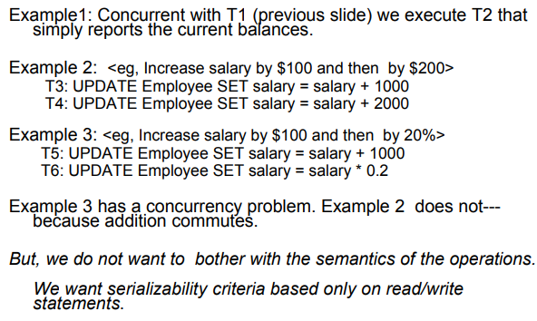
Concurrent Executions
Examples:

Slide 31
Serializability
When multiple transactions are running concurrently then there is a possibility that the database may be left in an inconsistent state.
Serializability is a concept that helps us to check which schedules are serializable.
A serializable schedule is the one that always leaves the database in consistent state.

Slide 32
What is a serializable schedule?
A serializable schedule always leaves the database in consistent state.
A serial schedule is always a serializable schedule because in serial schedule, a transaction only starts when the other transaction finished execution.
However a non-serial schedule needs to be checked for Serializability.

Slide 33
What is a serializable schedule?
A non-serial schedule of n number of transactions is said to be serializable schedule, if it is equivalent to the serial schedule of those n transactions.
A serial schedule doesn’t allow concurrency, only one transaction executes at a time and the other starts when the already running transaction finished.

Slide 34
Types of Serializability
There are two types of Serializability.
1. Conflict Serializability
2. View Serializability

Slide 35
DBMS Conflict Serializability
There are two types of schedules -
Serial & Non-Serial. A Serial schedule doesn’t support concurrent execution of transactions while a non-serial schedule supports concurrency.
Conflict Serializability is one of the type of Serializability, which can be used to check whether a non-serial schedule is conflict serializable or not.
What is Conflict Serializability?
A schedule is called conflict serializable if we can convert it into a serial schedule after swapping its non-conflicting operations.

Slide 36
DBMS Conflict Serializability
Conflicting operations
Two operations are said to be in conflict, if they satisfy all the following three conditions:
1. Both the operations should belong to different transactions.
2. Both the operations are working on same data item.
3. At least one of the operation is a write operation.

Slide 37
DBMS Conflict Serializability
Example 1: Operation W(X) of transaction T1 and operation R(X) of transaction T2 are conflicting operations, because they satisfy all the three conditions mentioned above.
They belong to different transactions, they are working on same data item X, one of the operation in write operation.
Example 2: Similarly Operations W(X) of T1 and W(X) of T2 are conflicting operations.

Slide 38
DBMS Conflict Serializability
Example 3: Operations W(X) of T1 and W(Y) of T2 are non-conflicting operations because both the write operations are not working on same data item so these operations don’t satisfy the second condition.
Example 4: Similarly R(X) of T1 and R(X) of T2 are non-conflicting operations because none of them is write operation.
Example 5: Similarly W(X) of T1 and R(X) of T1 are non-conflicting operations because both the operations belong to same transaction T1.

Slide 39
DBMS Conflict Serializability
Conflict Equivalent Schedules
Two schedules are said to be conflict Equivalent if one schedule can be converted into other schedule after swapping non-conflicting operations.
Conflict Serializable check
Lets check whether a schedule is conflict serializable or not. If a schedule is conflict Equivalent to its serial schedule then it is called Conflict Serializable schedule. Lets take few examples of schedules.

Slide 40
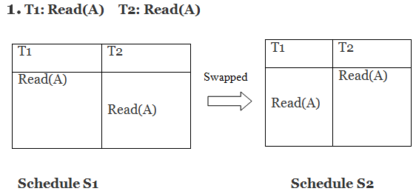
DBMS Conflict Serializability
Example:
Swapping is possible only if S1 and S2 are logically equal.
Here, S1 = S2. That means it is non-conflict.

Slide 41
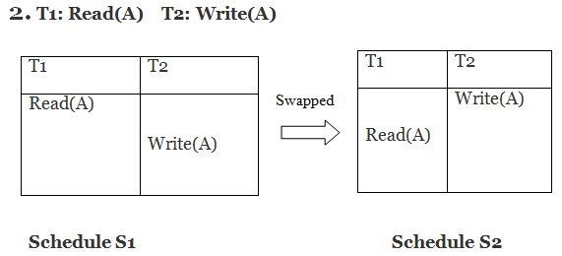
DBMS Conflict Serializability
Example:
Swapping is possible only if S1 and S2 are logically equal.
Here, S1 ≠ S2. That means it is conflict.

Slide 42
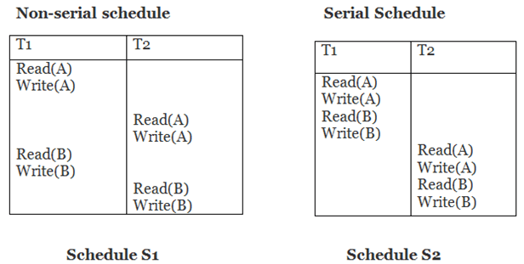
DBMS Conflict Serializability
Example:
Schedule S2 is a serial schedule because, in this, all operations of T1 are performed before starting any operation of T2. Schedule S1 can be transformed into a serial schedule by swapping non-conflicting operations of S1.

Slide 43

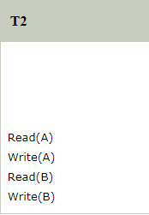
DBMS Conflict Serializability
After swapping of non-conflict operations, the schedule S1 becomes:
Since, S1 is conflict serializable.

Slide 44
DBMS View Serializability
A schedule will view serializable if it is view equivalent to a serial schedule.
If a schedule is conflict serializable, then it will be view serializable.
The view serializable which does not conflict serializable contains blind writes.
Schedule S2 is a serial schedule because, in this, all operations of T1 are performed before starting any operation of T2. Schedule S1 can be transformed into a serial schedule by swapping non-conflicting operations of S1.

Slide 45
DBMS View Serializability
View Equivalent
Two schedules S1 and S2 are said to be view equivalent if they satisfy the following conditions:
1. Initial Read
2. Updated Read
3. Final Write

Slide 46
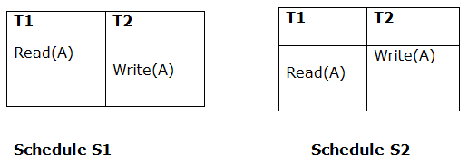
DBMS View Serializability
1. Initial Read
An initial read of both schedules must be the same. Suppose two schedule S1 and S2. In schedule S1, if a transaction T1 is reading the data item A, then in S2, transaction T1 should also read A.
Above two schedules are view equivalent because Initial read operation in S1 is done by T1 and in S2 it is also done by T1.

Slide 47
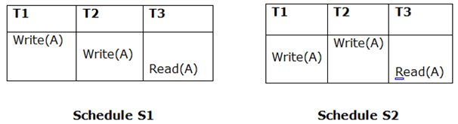
DBMS View Serializability
2. Updated Read
In schedule S1, if Ti is reading A which is updated by Tj then in S2 also, Ti should read A which is updated by Tj.
Above two schedules are not view equal because, in S1, T3 is reading A updated by T2 and in S2, T3 is reading A updated by T1.

Slide 48
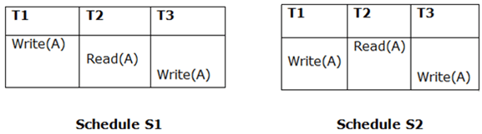
DBMS View Serializability
3. Final Write
A final write must be the same between both the schedules. In schedule S1, if a transaction T1 updates A at last then in S2, final writes operations should also be done by T1.
Above two schedules is view equal because Final write operation in S1 is done by T3 and in S2, the final write operation is also done by T3.

Slide 49
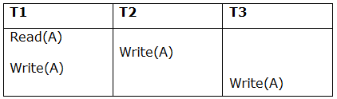
DBMS View Serializability
Example:
Schedule S
With 3 transactions, the total number of possible schedule
= 3! = 6
S1 = <T1 T2 T3>
S2 = <T1 T3 T2>
S3 = <T2 T3 T1>
S4 = <T2 T1 T3>
S5 = <T3 T1 T2>
S6 = <T3 T2 T1>

Slide 50
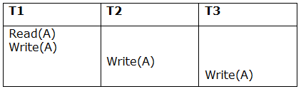
DBMS View Serializability
Taking first schedule S1:
Schedule S1
Step 1: final updation on data items
In both schedules S and S1, there is no read except the initial read that's why we don't need to check that condition.

Slide 51
DBMS View Serializability
Step 2: Initial Read
The initial read operation in S is done by T1 and in S1, it is also done by T1.
Step 3: Final Write
The final write operation in S is done by T3 and in S1, it is also done by T3. So, S and S1 are view Equivalent.
The first schedule S1 satisfies all three conditions, so we don't need to check another schedule.
Hence, view equivalent serial schedule is:
T1 → T2 → T3

Slide 52
Concurrency Control
In the concurrency control, the multiple transactions can be executed simultaneously.
It may affect the transaction result. It is highly important to maintain the order of execution of those transactions.
Concurrency control is the procedure in DBMS for managing simultaneous operations without conflicting with each another.

Slide 53
Concurrency Control
In a multiprogramming environment where multiple transactions can be executed simultaneously, it is highly important to control the concurrency of transactions. We have concurrency control protocols to ensure atomicity, isolation, and serializability of concurrent transactions. Concurrency control protocols can be broadly divided into two categories −
Lock based protocols
Time stamp based protocols

Slide 54
Lock-based Protocols
Database systems equipped with lock-based protocols use a mechanism by which any transaction cannot read or write data until it acquires an appropriate lock on it. Locks are of two kinds −
Binary Locks
Shared/exclusive

Slide 55
Lock-based Protocols
Binary Locks − A lock on a data item can be in two states; it is either locked or unlocked.
Shared/exclusive − This type of locking mechanism differentiates the locks based on their uses. If a lock is acquired on a data item to perform a write operation, it is an exclusive lock.
Allowing more than one transaction to write on the same data item would lead the database into an inconsistent state. Read locks are shared because no data value is being changed.

Slide 56
Recovery System
DBMS is a highly complex system with hundreds of transactions being executed every second.
The durability and robustness of a DBMS depends on its complex architecture and its underlying hardware and system software.
If it fails or crashes amid transactions, it is expected that the system would follow some sort of algorithm or techniques to recover lost data.

Slide 57
Recovery System
DBMS is a highly complex system with hundreds of transactions being executed every second.
The durability and robustness of a DBMS depends on its complex architecture and its underlying hardware and system software.
If it fails or crashes amid transactions, it is expected that the system would follow some sort of algorithm or techniques to recover lost data.

Slide 58
Recovery System
Failure Classification
Various categories, as follows −
Transaction failure -
A transaction has to abort when it fails to execute or when it reaches a point from where it can’t go any further.
This is called transaction failure where only a few transactions or processes are hurt.

Slide 59
Recovery System
Failure Classification
Reasons for a transaction failure could be −
Logical errors − Where a transaction cannot complete because it has some code error or any internal error condition.
System errors − Where the database system itself terminates an active transaction because the DBMS is not able to execute it, or it has to stop because of some system condition. For example, in case of deadlock or resource unavailability, the system aborts an active transaction.

Slide 60
Recovery System
Failure Classification
Various categories, as follows −
Transaction failure -
A transaction has to abort when it fails to execute or when it reaches a point from where it can’t go any further.
This is called transaction failure where only a few transactions or processes are hurt.

Slide 61
Recovery System
Disk Failure
In early days of technology evolution, it was a common problem where hard-disk drives or storage drives used to fail frequently.
Disk failures include formation of bad sectors, unreachability to the disk, disk head crash or any other failure, which destroys all or a part of disk storage.

Slide 62
Recovery System
Storage Structure
The storage structure can be divided into two categories −
Volatile storage − As the name suggests, a volatile storage cannot survive system crashes. Volatile storage devices are placed very close to the CPU; normally they are embedded onto the chipset itself. For example, main memory and cache memory are examples of volatile storage. They are fast but can store only a small amount of information.

Slide 63
Recovery System
Storage Structure
The storage structure can be divided into two categories −
Non-volatile storage − These memories are made to survive system crashes. They are huge in data storage capacity, but slower in accessibility. Examples may include hard-disks, magnetic tapes, flash memory, and non-volatile (battery backed up) RAM.

Slide 64
Recovery System
Recovery and Atomicity
When a system crashes, it may have several transactions being executed and various files opened for them to modify the data items.
Transactions are made of various operations, which are atomic in nature. But according to ACID properties of DBMS, atomicity of transactions as a whole must be maintained, that is, either all the operations are executed or none.

Slide 65
Recovery System
When a DBMS recovers from a crash, it should maintain the following −
It should check the states of all the transactions, which were being executed.
A transaction may be in the middle of some operation; the DBMS must ensure the atomicity of the transaction in this case.
It should check whether the transaction can be completed now or it needs to be rolled back.
No transactions would be allowed to leave the DBMS in an inconsistent state.

Slide 66
Recovery System
There are two types of techniques, which can help a DBMS in recovering as well as maintaining the atomicity of a transaction −
Maintaining the logs of each transaction, and writing them onto some stable storage before actually modifying the database.
Maintaining shadow paging, where the changes are done on a volatile memory, and later, the actual database is updated.

Slide 67
Recovery System
Log-based Recovery
Log is a sequence of records, which maintains the records of actions performed by a transaction. It is important that the logs are written prior to the actual modification and stored on a stable storage media, which is failsafe.
Log-based recovery works as follows −
The log file is kept on a stable storage media.
When a transaction enters the system and starts execution, it writes a log about it.

Slide 68
Recovery System
Checkpoint
Keeping and maintaining logs in real time and in real environment may fill out all the memory space available in the system.
As time passes, the log file may grow too big to be handled at all. Checkpoint is a mechanism where all the previous logs are removed from the system and stored permanently in a storage disk.
Checkpoint declares a point before which the DBMS was in consistent state, and all the transactions were committed.

Slide 69
Deadlock in DBMS
In a database, a deadlock is an unwanted situation in which two or more transactions are waiting indefinitely for one another to give up locks.
Deadlock is said to be one of the most feared complications in DBMS as it brings the whole system to a Halt.

Slide 70
Deadlock in DBMS
Example – let us understand the concept of Deadlock with an example :
Suppose, Transaction T1 holds a lock on some rows in the Students table and needs to update some rows in the Grades table.
Simultaneously, Transaction T2 holds locks on those very rows (Which T1 needs to update) in the Grades table but needs to update the rows in the Student table held by Transaction T1.

Slide 71
Deadlock in DBMS
Now, the main problem arises. Transaction T1 will wait for transaction T2 to give up lock, and similarly transaction T2 will wait for transaction T1 to give up lock.
As a consequence, All activity comes to a halt and remains at a standstill forever unless the DBMS detects the deadlock and aborts one of the transactions.

Slide 72
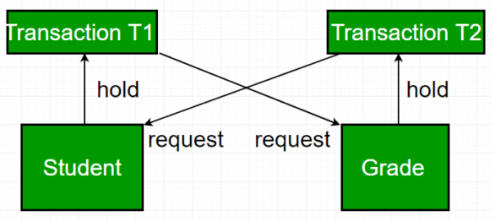
Deadlock in DBMS

